Slide 1
LINEAR CONTROL
SYSTEMS
Ali Karimpour
Assistant Professor
Ferdowsi University of Mashhad
Notes:
<<<1.1>>>
###Control System Design###
{{{Control, Design}}}

Slide 2
Lecture 5
Nonlinear systems
Topics to be covered include:
Nonlinear systems
Linearization of nonlinear systems
Transfer function representation

Slide 3
Nonlinear systems.
سیستمهای غیر خطی
Although almost every real system includes nonlinear features, many systems can be reasonably described, at least within certain operating ranges, by linear models.
گرچه تقریبا تمام سیستمهای واقعی دارای رفتار غیر خطی هستند، بسیاری از سیستمها را می توان حداقل در یک رنج کاری خاص خطی نمود.
Notes:
<<<3.10>>>
###Model Linearization###

Slide 4
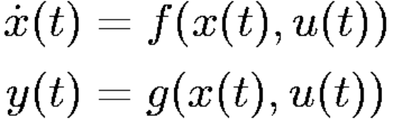
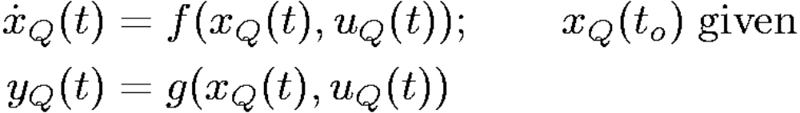
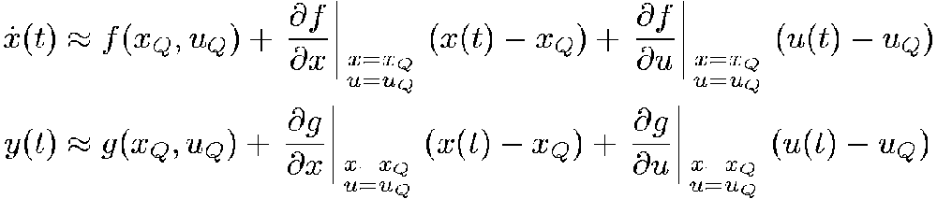
Nonlinear systems.
سیستمهای غیر خطی
Say that {x_{Q}(t), u_{Q}(t), y_{Q}(t)} is a given set of trajectories that satisfy the above equations, so we have

Slide 5
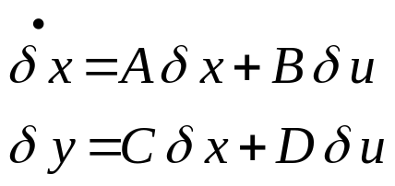
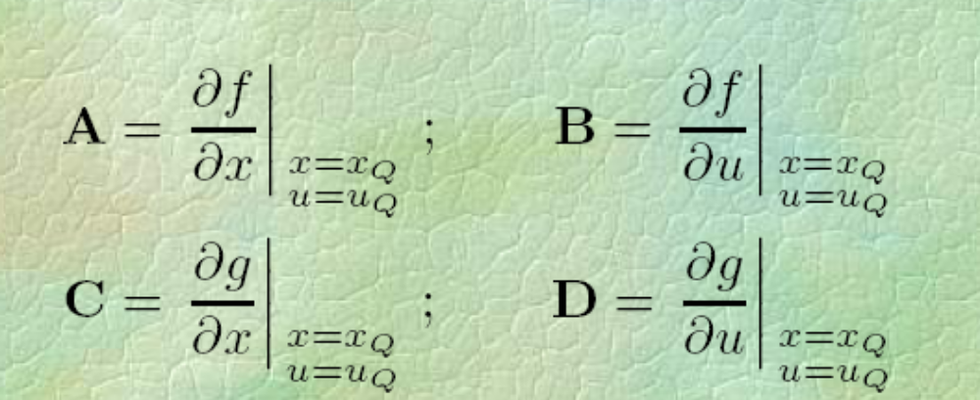
Linearized system
سیستم خطی شده

Slide 6
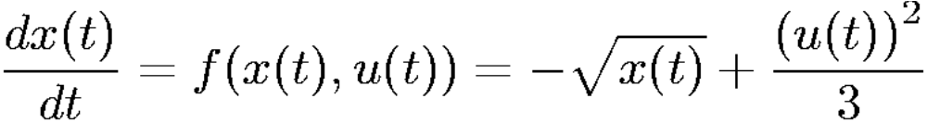
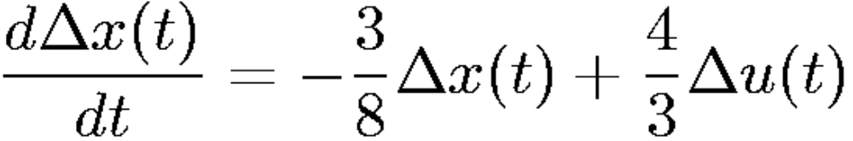
Example 1
Consider a continuous time system with true model given by
Assume that the input u(t) fluctuates around u = 2. Find an operating point with u_{Q} = 2 and a linearized model around it.

Slide 7
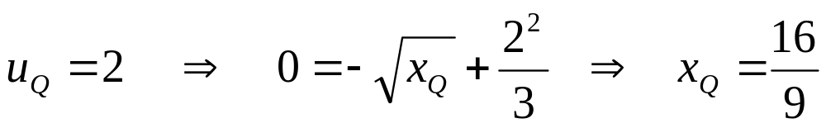
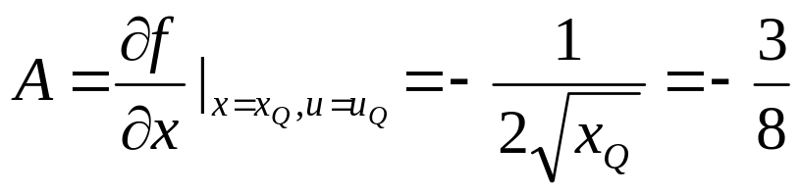
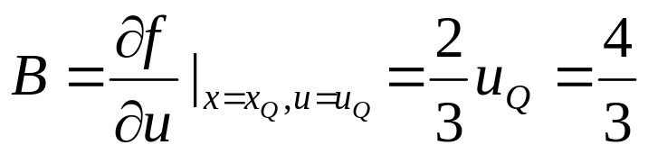
Example 1 (Continue)

Slide 8
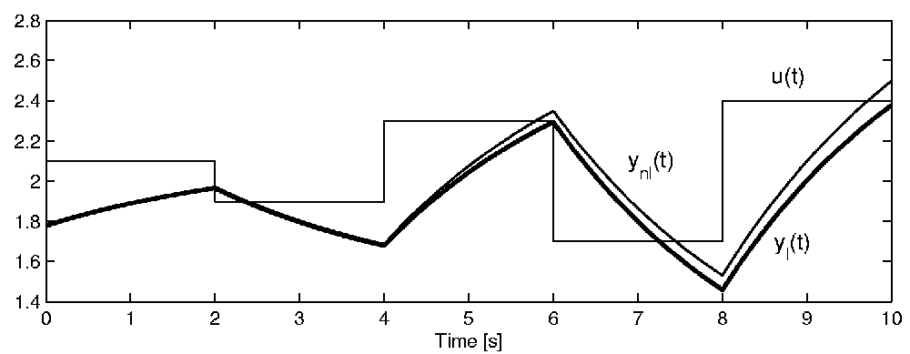
Simulation
شبیه سازی

Slide 9
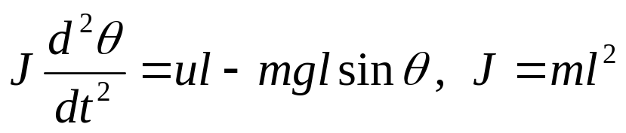
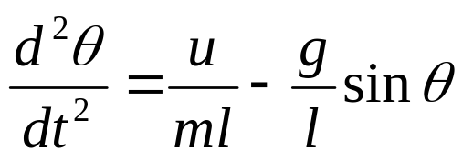

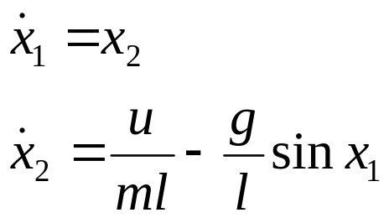
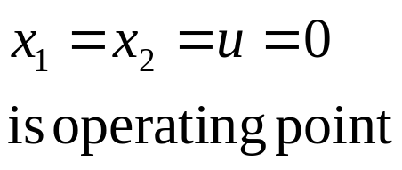
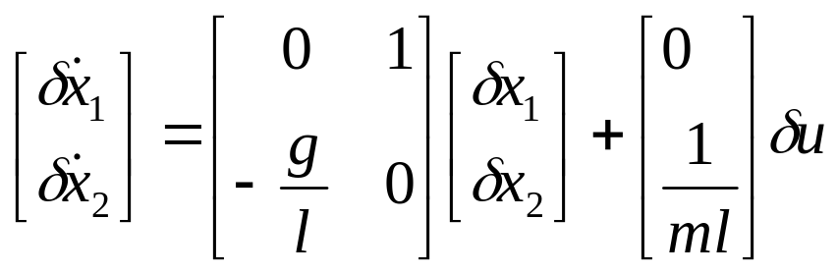
Example 2 (Pendulum)
Find the linear model around equilibrium point.
θ
l
u
mg
Remark: There is also another equilibrium point at x₂=u=0, x₁=π

Slide 10

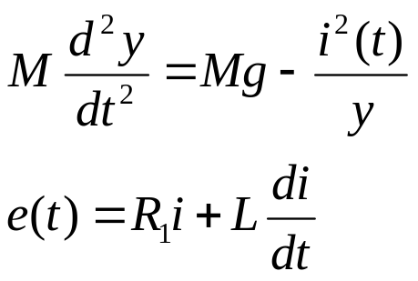


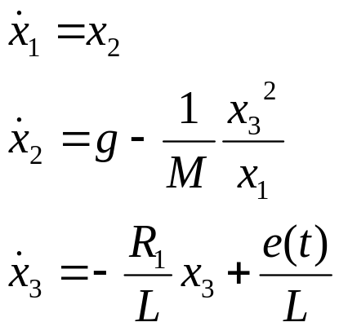
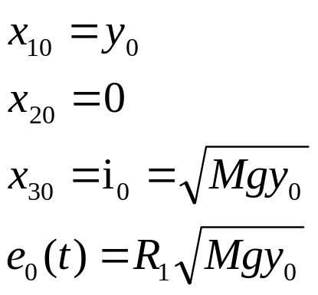
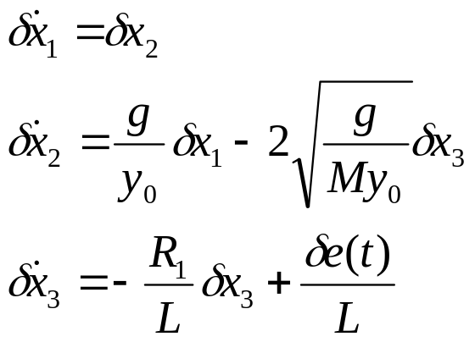
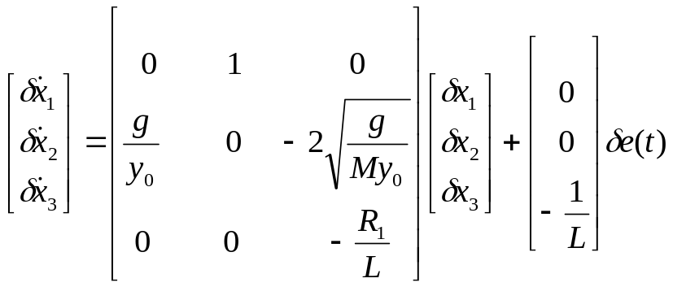
Example 3 Suppose electromagnetic force is i²/y and find linearzed model around y=y₀
y
M

Slide 11
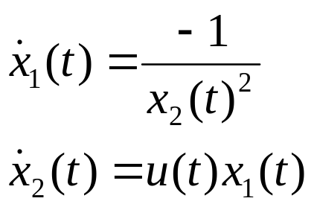
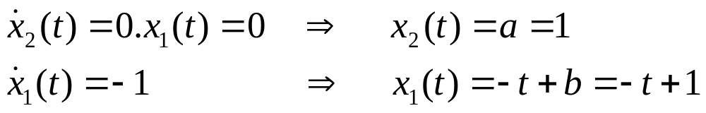
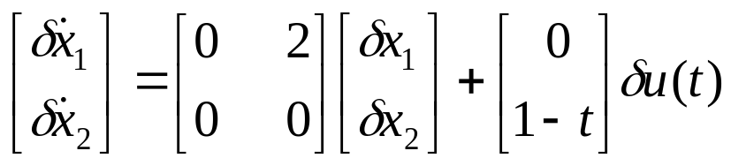
Example 4 Consider the following nonlinear system. Linearize it x₁₀=x₂₀=1, u(t)=0

Slide 12
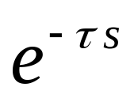
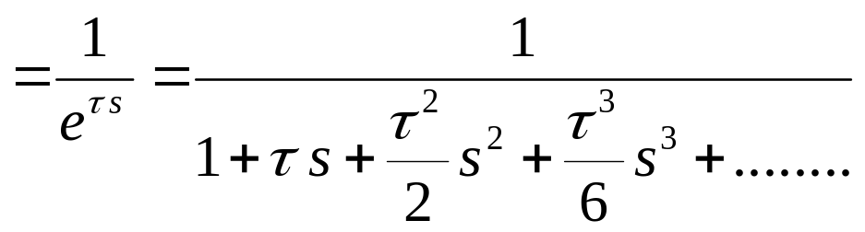
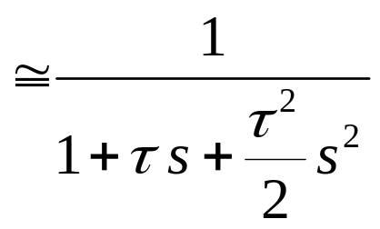
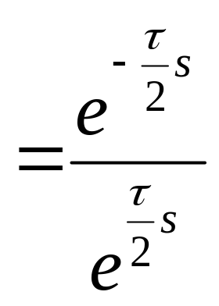
Linear model for time delay
τ
1
−
s
≅
2
Pade approximation
τ
1
+
s
2

Slide 13
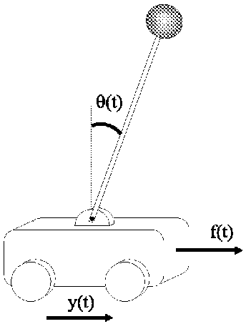
Example 5(Inverted pendulum)
مثال 5 پاندول معکوس
Figure 3.5: Inverted pendulum
In Figure 3.5, we have used the following notation:
y(t) - distance from some reference point
θ(t) - angle of pendulum
M - mass of cart
m - mass of pendulum (assumed concentrated at tip)
l - length of pendulum
f(t) - forces applied to pendulum
Notes:
{{{Inverted Pendulum}}}

Slide 14
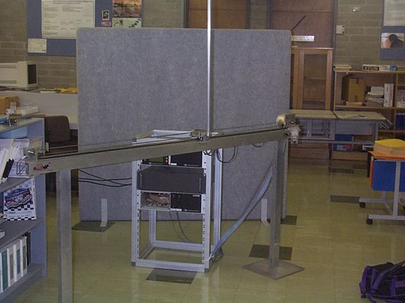
Example of an Inverted Pendulum

Slide 15
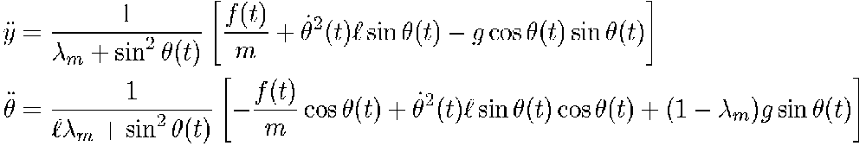
Nonlinear model
Application of Newtonian physics to this system leads to the following model:
where λ_{m} = (M/m)

Slide 16
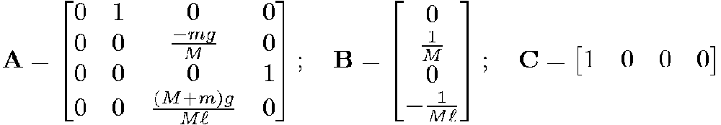
Linear model
This is a linear state space model in which A, B and C are:

Slide 17
TF model properties
خواص مدل تابع انتقال
1- It is available just for linear time invariant systems. (LTI)
2- It is derived by zero initial condition.
3- It just shows the relation between input and output so it may lose some information.
4- It is just dependent on the structure of system and it is independent to the input value and type.
5- It can be used to show delay systems but SS can not.

Slide 18
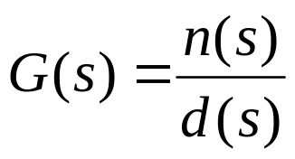
Poles of Transfer function
قطب تابع انتقال
Transfer function
Pole: s=p is a value of s that the absolute value of TF is infinite.
How to find it?
Let d(s)=0 and find the roots
Why is it important?
It shows the behavior of the system.
See the next example to understand

Slide 19
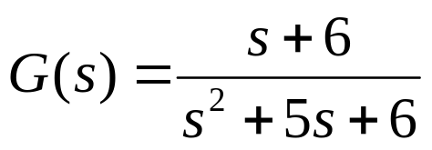
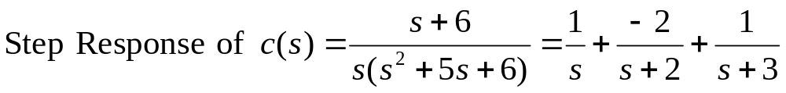

Example 1
Poles and their physical meaning
قطبها و خواص فیریکی آنها
Transfer function
S²+5s+6=0 → p₁= -2, p₂=-3
roots([1 5 6])
p₁= -2, p₂=-3

Slide 20
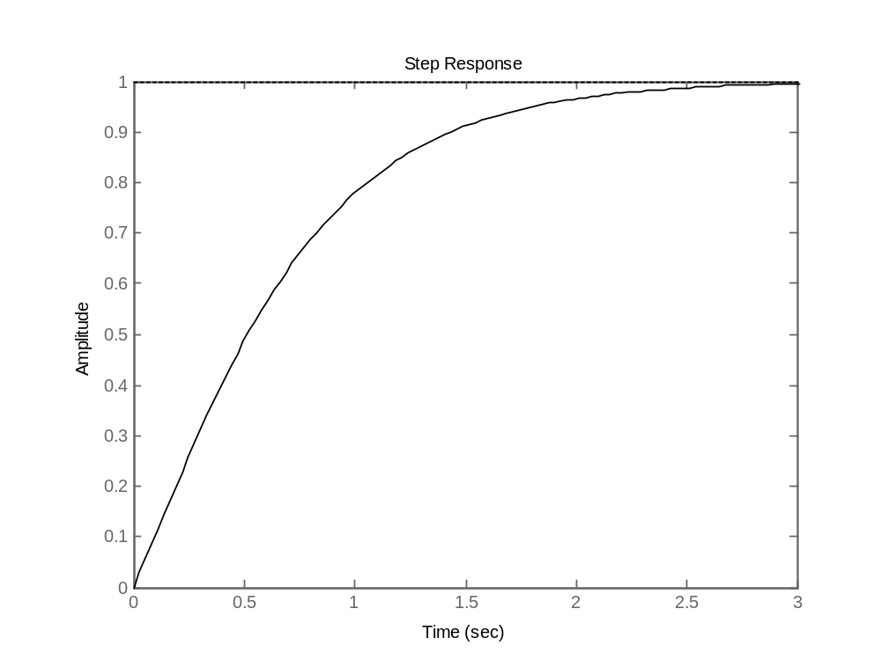
Example 1 (Continue)
Transfer function
step([1 6],[1 5 6])

Slide 21
Zeros of Transfer function
صفر تابع انتقال
Transfer function
Zero: s=z is a value of s that the absolute value of TF is zero.
How to find it?
Let n(s)=0 and find the roots
Why is it important?
It also shows the behavior of system.
See the next example to understand

Slide 22
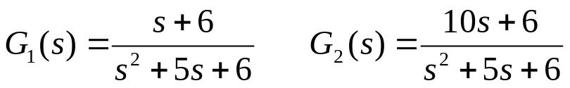
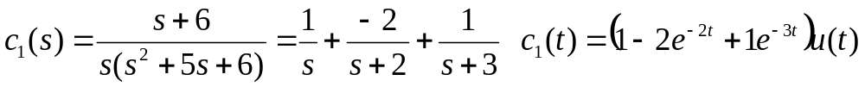
Example 2
Zeros and their physical meaning
صفرها و خواص فیریکی آنها
Transfer functions
z₁= -6 z₂=-0.6

Slide 23
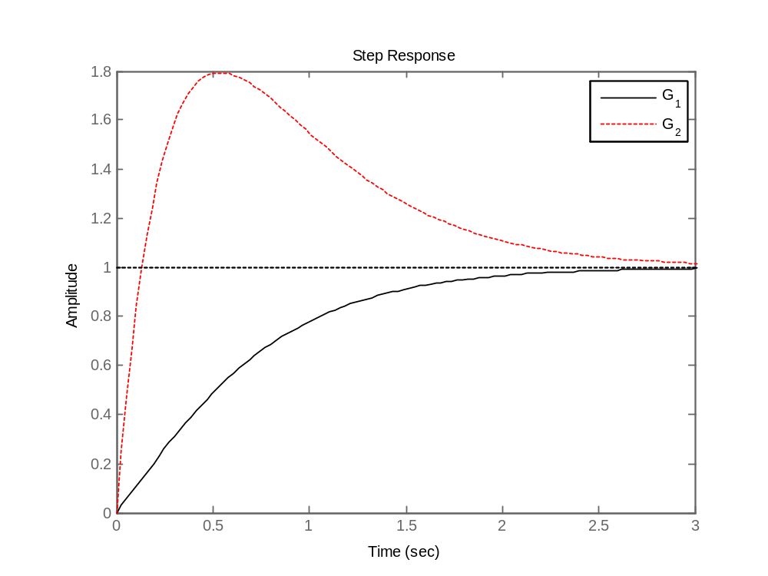
Example 2
Zeros and their physical meaning
صفرها و خواص فیریکی آنها
Transfer function
step([1 6],[1 5 6])
;hold on;step([10 6],[1 5 6])

Slide 24
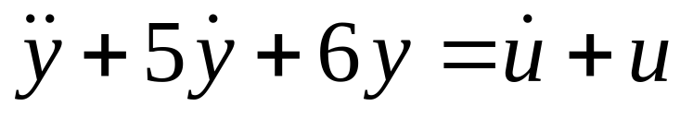
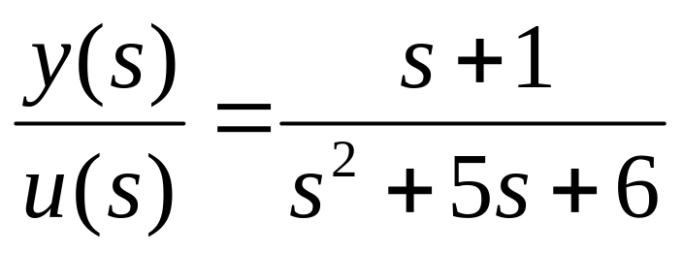
Example 3
Zeros and its physical meaning
صفرها و خواص فیریکی آنها
Transfer function of the system is:
It has a zero at z=-1
u=e^{-1t} and suitable y₀ and y’₀ leads to y(t)=0
What does it mean?

Slide 25
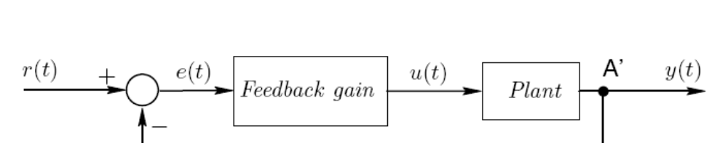
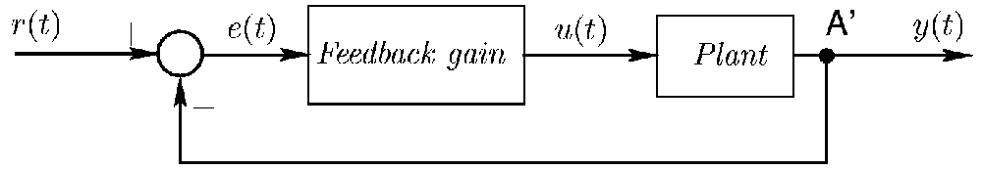
Open loop and closed loop systems
سیستمهای حلقه باز و حلقه بسته
Open
loop
Controller
Closed
loop
Controller
Notes:
<<<2.7>>>
###Closed Loop Architecture###

Slide 26
When is the open loop representation applicable?
در چه شرایطی کنترل حلقه باز مناسب است؟
The model on which the design of the controller has been based is a very good representation of the plant,
The model must be stable, and
Disturbances and initial conditions are negligible.
Notes:
<<<2.7>>>
###Closed Loop Architecture###

Slide 27
SISO and MIMO
سیستم تک ورودی تک خروجی و چند ورودی چند خروجی
u₁
System
y₁
SISO
u₁
y₁
u₂
System
y₂
u₃
y₃
MIMO
Notes:
<<<2.7>>>
###Closed Loop Architecture###

Slide 28
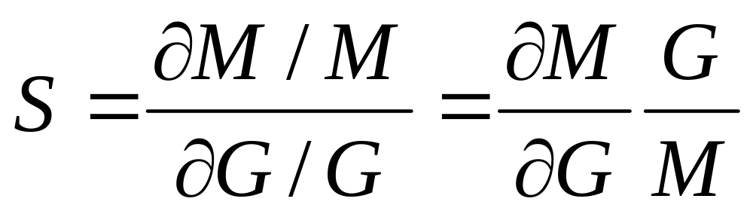
Sensitivity
حساسیت
Sensitivity is defined as:
M is the system + controller transfer function
G is the system transfer function
Notes:
<<<2.7>>>
###Closed Loop Architecture###

Slide 29
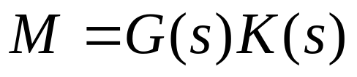
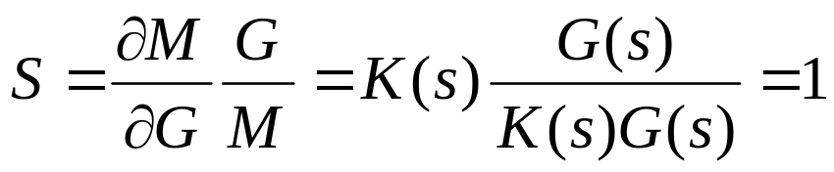
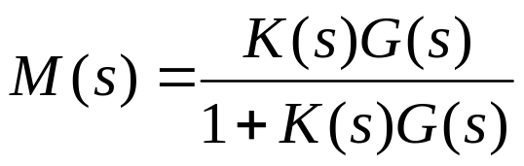
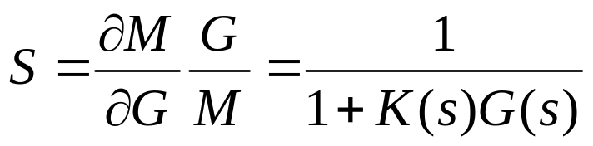
Sensitivity
حساسیت
r
c
K(s)
G(s)
Open loop system
r
c
+
K(s)
G(s)
-
Closed loop system
Notes:
<<<2.7>>>
###Closed Loop Architecture###

Slide 30
Feedback properties
ویژگیهای فیدبک
Feedback can effect:
system gain
system stability
c) system sensitivity
d) noise and disturbance
Notes:
<<<2.7>>>
###Closed Loop Architecture###

Slide 31
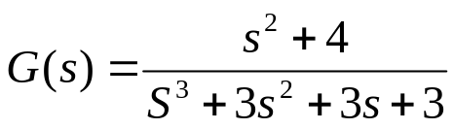

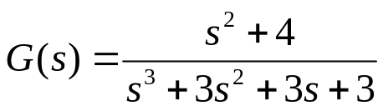

Exercises
تمرين
5-1 Find the poles and zeros of following system.
5-2 Is it possible to apply a nonzero input to the following system
for t>0, but the output be zero for t>0? Show it.
5-3 Find the step response of following system.
5-4 Find the step response of following system for a=1,3,6 and 9.

Slide 32
Exercises
تمرين
5-4 Find the linear model of system in example 2 around
x₂=u=0, x₁=π

